Slide 1



Web Application for Online Marketplace
Project ID : 18D76
PRESENTED BY :
SYED JAMAL HARRIS R – 18CSR215
SUNDARESHWAR V A – 18CSR206
SIVAKUMAR P – 18CSR190
GUIDED BY : Dr N KRISHNAMOORTHY
Department of Computer Science and Engineering

Slide 2
PROBLEM STATEMENT
TO CREATE A WEB APPLICATION WHICH IS SUITABLE FOR ANY BROWSER ENVIRONMENT.
DEVELOPING WEB APPLICATION ACCORDING TO THE REQUIREMENTS GIVEN BY THE CUSTOMER AND TO MAKE THE DEVELOPED WEB APPLICATION USER FRIENDLY FOR EASY ACCESS.

Slide 3
SYSTEM STUDY & SCOPE OF THE PROJECT
This Web application can be build using React JS as front-end library, Node.js as back-end and MongoDB as database.
React is a free and open-source front-end JavaScript library for building user interfaces or UI components.
Node.js is an open-source, cross-platform, back-end JavaScript runtime environment that runs on the V8 engine and executes JavaScript code outside a web browser.
MongoDB is a source-available cross-platform document-oriented database program. Classified as a NoSQL database program,
Express.js, or simply Express, is a back end web application framework for Node.js, designed for building web applications and APIs.

Slide 4
MODULES IN THE PROJECT
The modules used here is different for User side and Admin side with constrains for proper retrieval of Data. The modules used are listed below,
Home
Service
Career
About
Course
Contact
Registration
Login

Slide 5
REQUIREMENT SPECIFICATION
FUNCTIONAL REQUIREMENTS
THE REQUIREMNTS FROM THE USER SIDE WERE GIVEN AND ANALYSED FOR REALITY CHECK OF IMPLEMENTATION.
THE REQUIREMENTS ARE SPECIFIED AS A FORM TO STORE DATA NAMELY CUSTOMER-NAME, CUSTOMER PH-NO, CUSTOMER MESSAGE, COURSE THAT CUSTOMER ENROLLED

Slide 6
NON-FUNCTIONAL REQUIREMENTS
THE WEB APLLICATION SHOULD BE PORTABLE, ADAPTABLE AND ACCESIBLE IN ALL BROWSERS.
IT IS ALSO ADAPTABLE TO ANY KIND OF COMPUTING DEVICE WITH INTERNET ACCESS
SECURITY AND RIGHTS ARE PROVIDED FOR THE ACCESS OF ADMIN AND ALSO CERTAIN RIGHTS FOR THE USER(CUSTOMER).

Slide 7
TECHNOLOGIES USED
HTML : HTML (Hypertext Markup Language) is the code that is used to structure a web page and its content
CSS : CSS is the language for describing the presentation of Web pages, including colors, layout, and fonts
BOOTSTRAP: Bootstrap is a free and open-source CSS framework directed at responsive, mobile-first front-end web development.
REACT JS : React is a free and open-source front-end JavaScript library for building user interfaces or UI components.

Slide 8
NODE JS : Node.js is an back-end JavaScript runtime environment that runs on the V8 engine and executes JavaScript code outside a web browser.
MONGO DB : MongoDB is a source-available cross-platform document-oriented database program. Classified as a NoSQL database program
EXPRESS JS : Express.js, or simply Express, is a back end web application framework for Node.js, designed for building web applications and APIs.

Slide 9
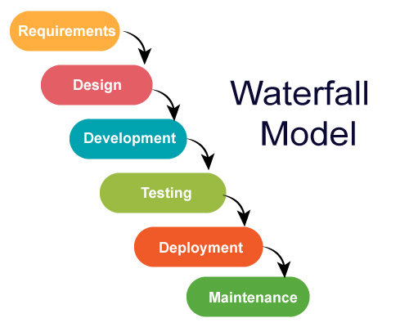
METHODOLOGIES USED
Waterfall Model is the methodology used in our project . Waterfall approach was first SDLC Model to be used widely in Software Engineering to ensure success of the project.
Since the requirements given by the customer are very clear, and there is no possibility of making further changes in future.So Waterfall model is used.

Slide 10
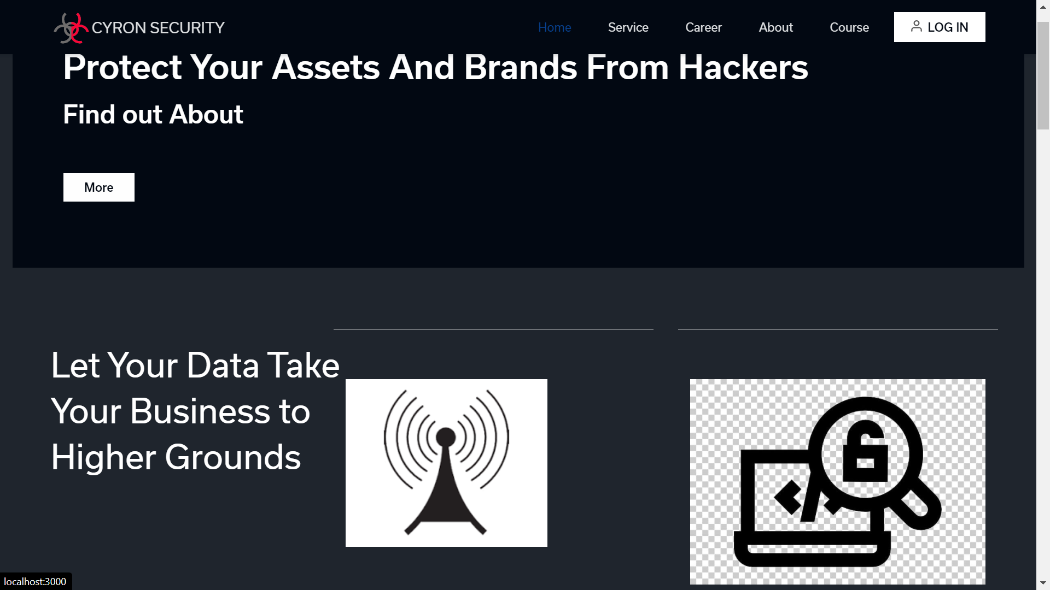
SAMPLE UI FOR PROJECT

Slide 11
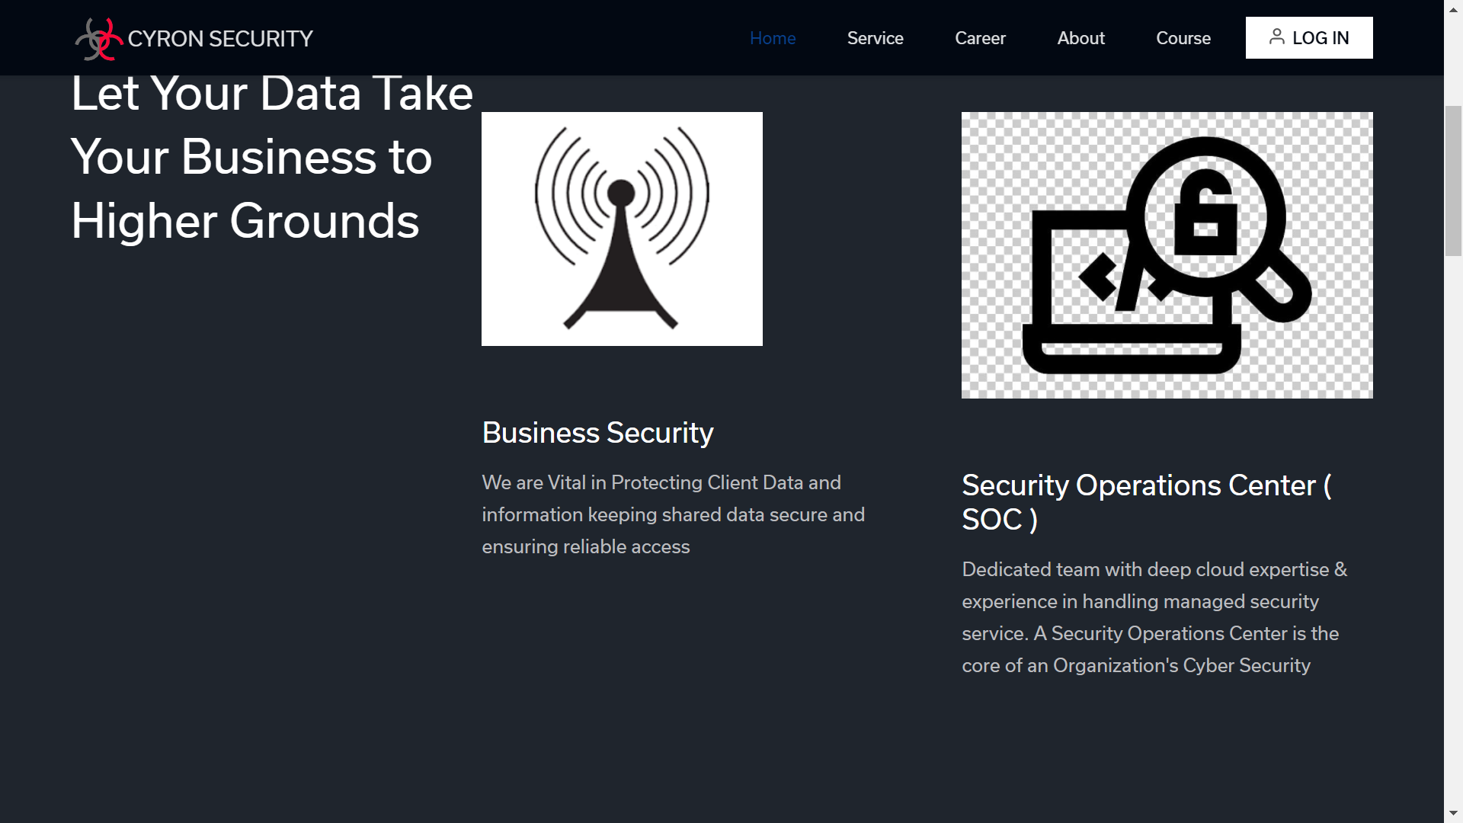

Slide 12
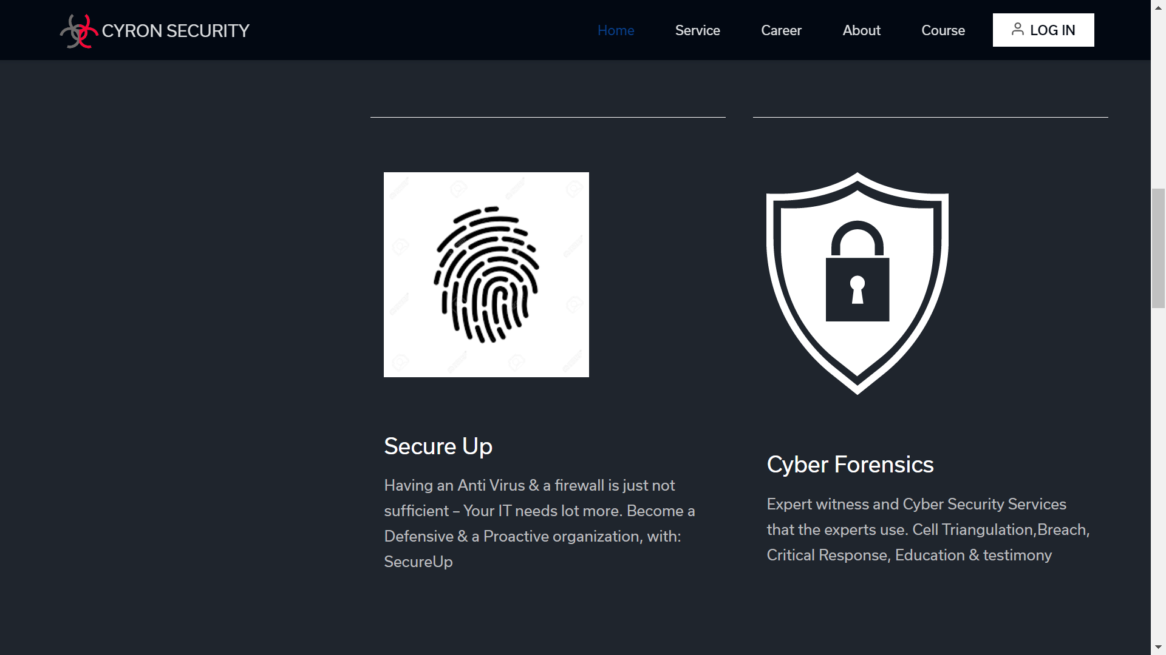

Slide 13
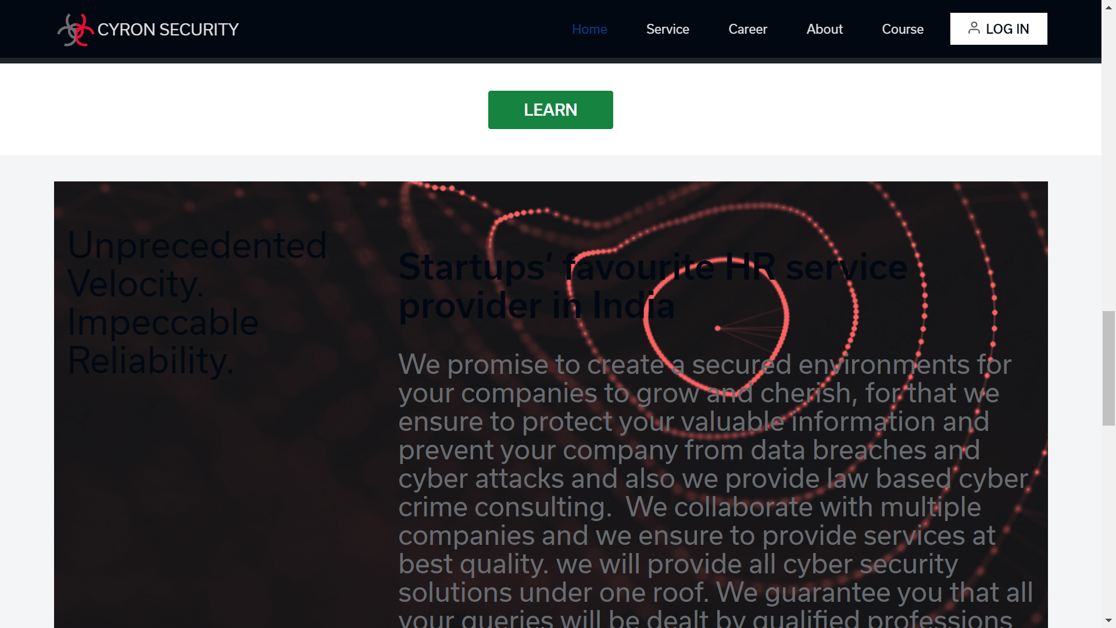

Slide 14
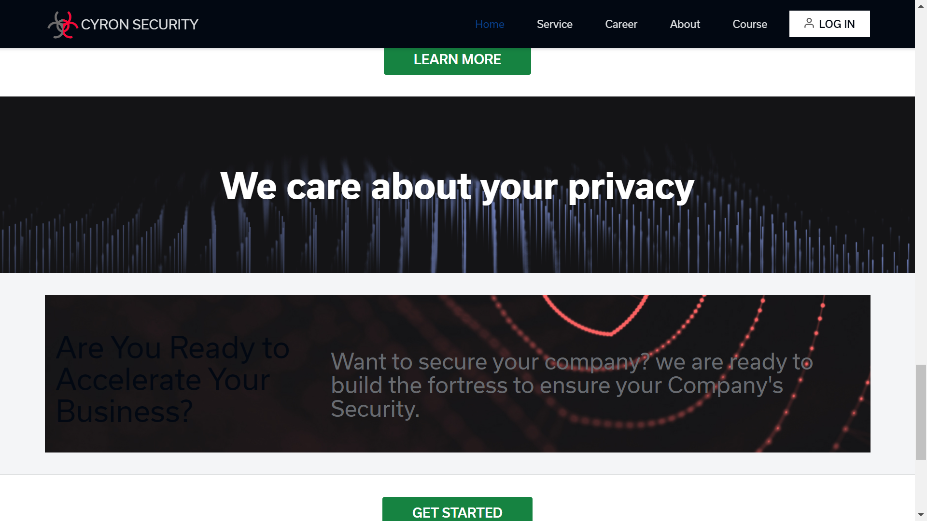

Slide 15
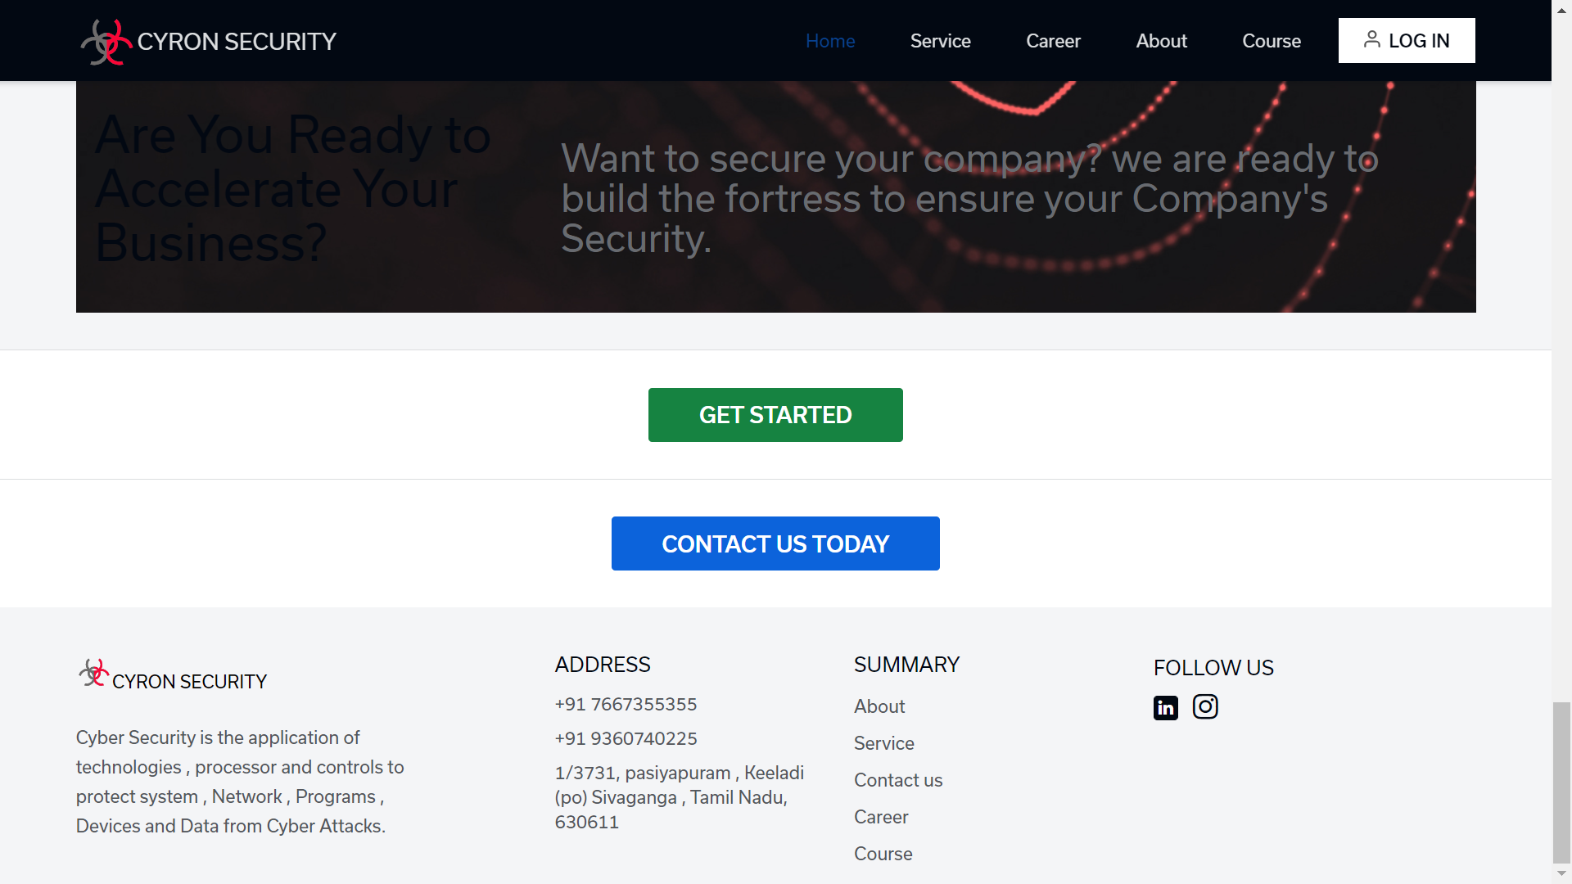

Slide 16


Slide 17
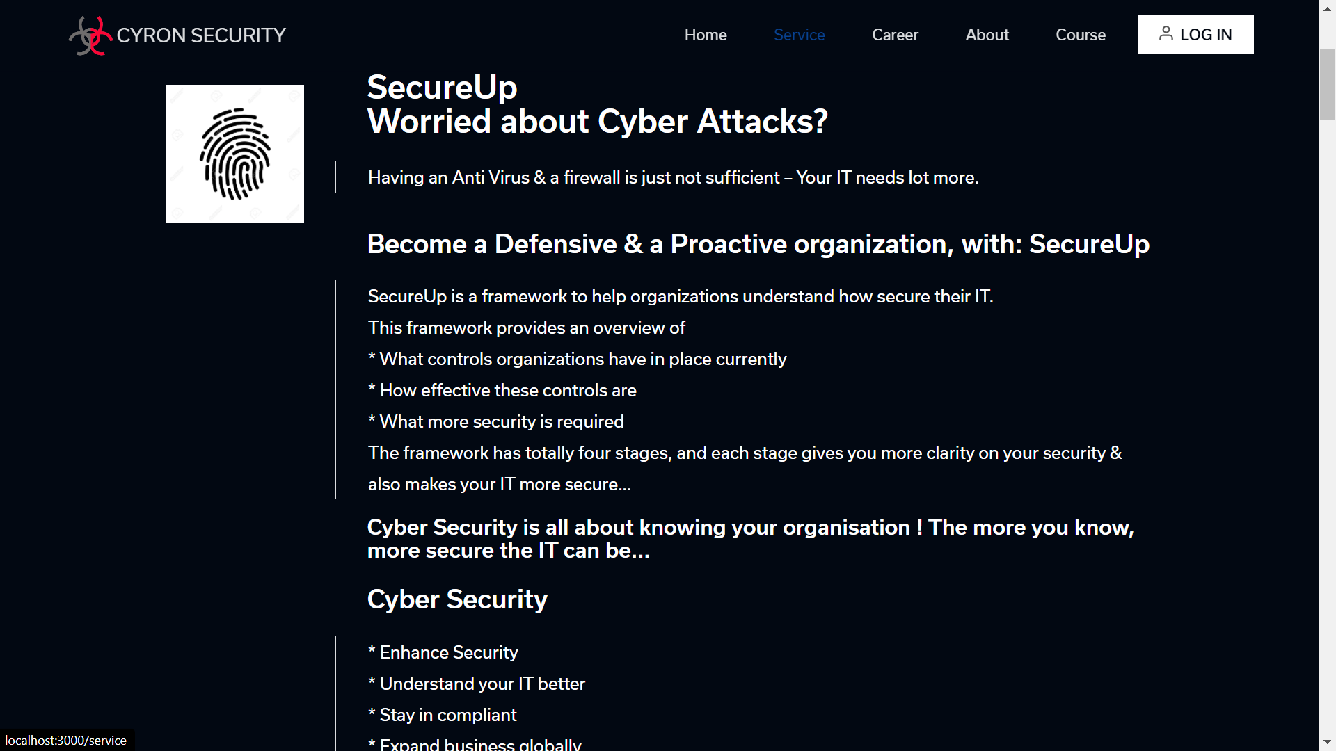

Slide 18
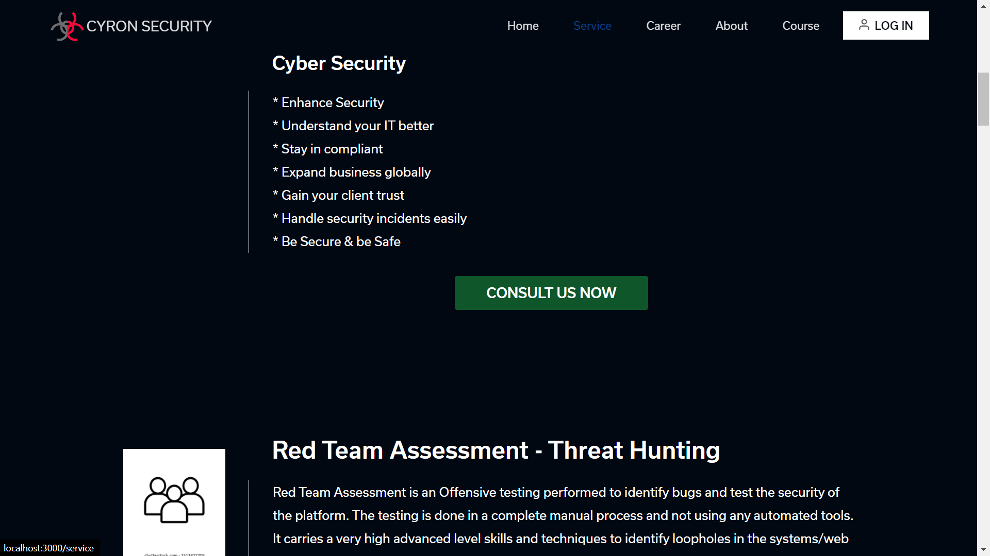

Slide 19
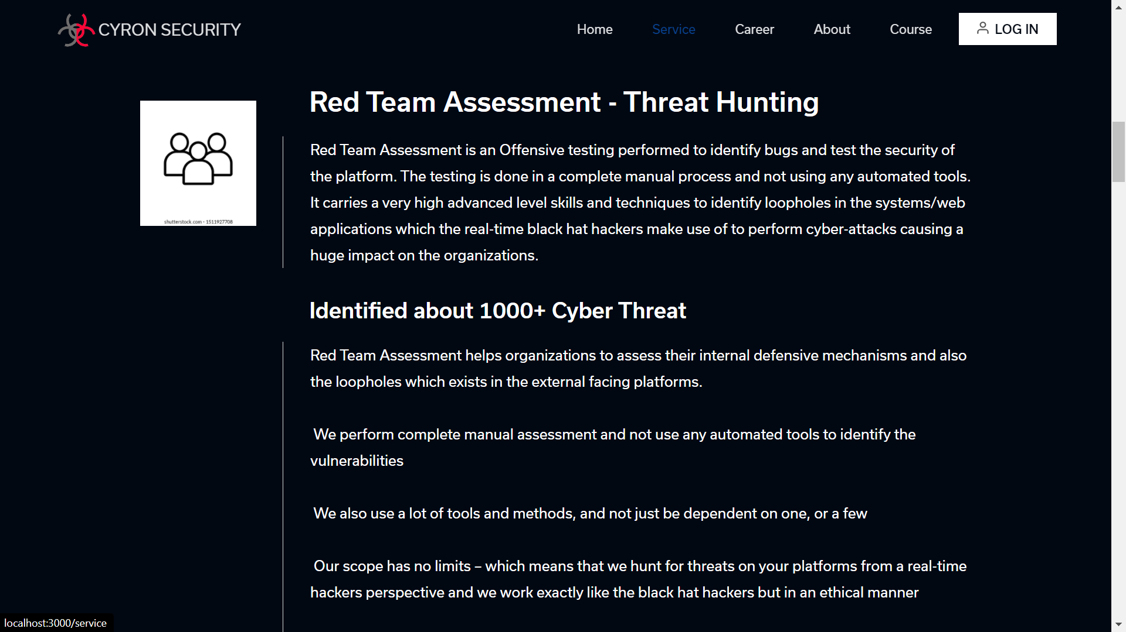

Slide 20
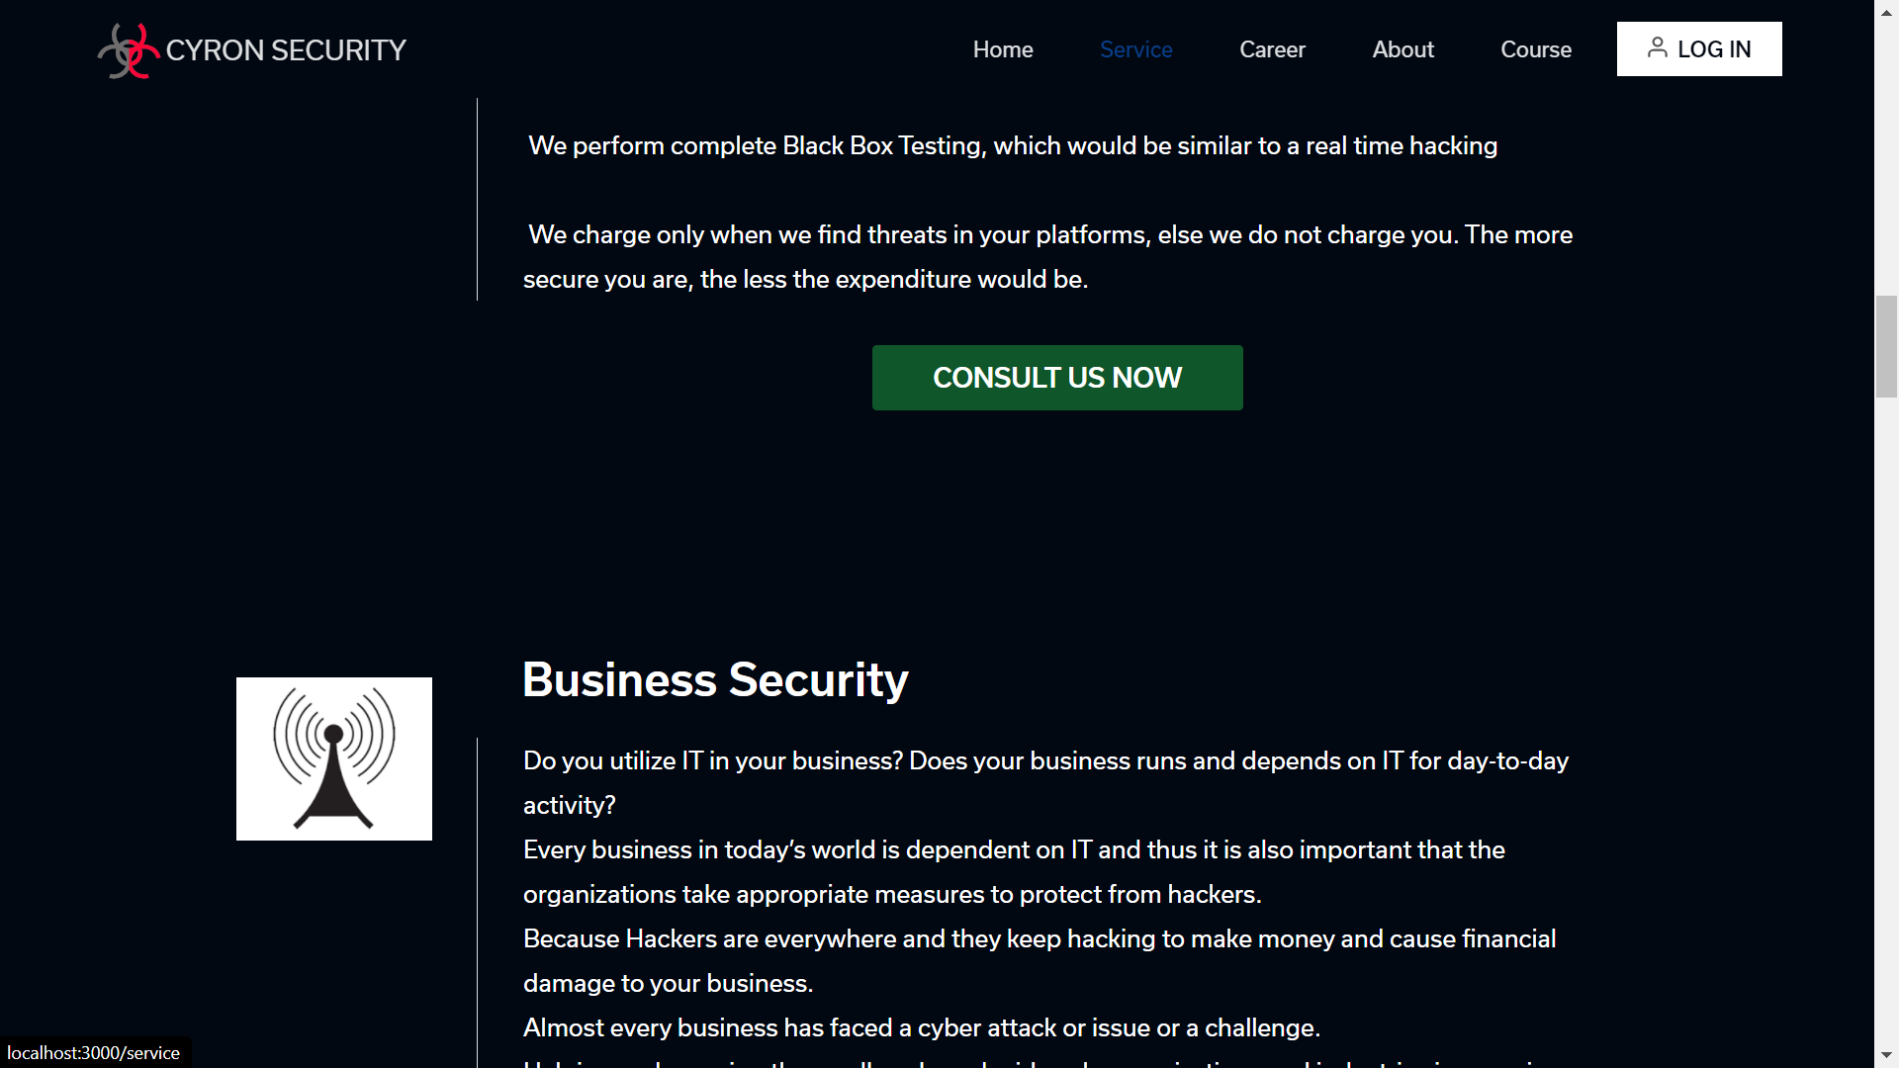

Slide 21
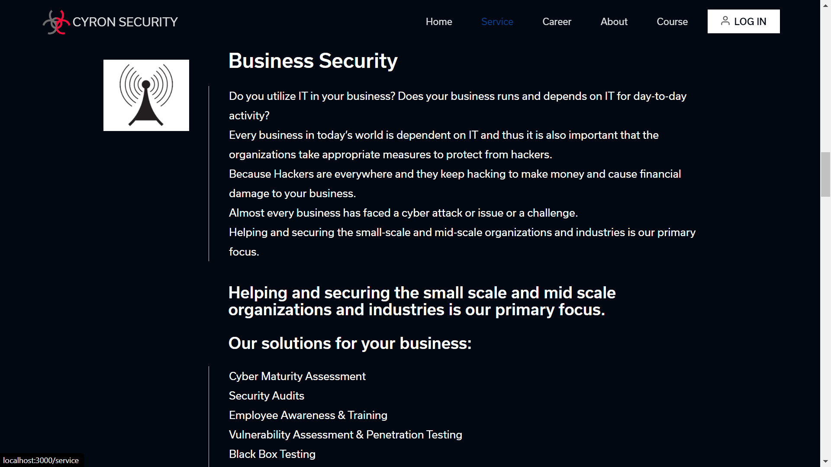

Slide 22
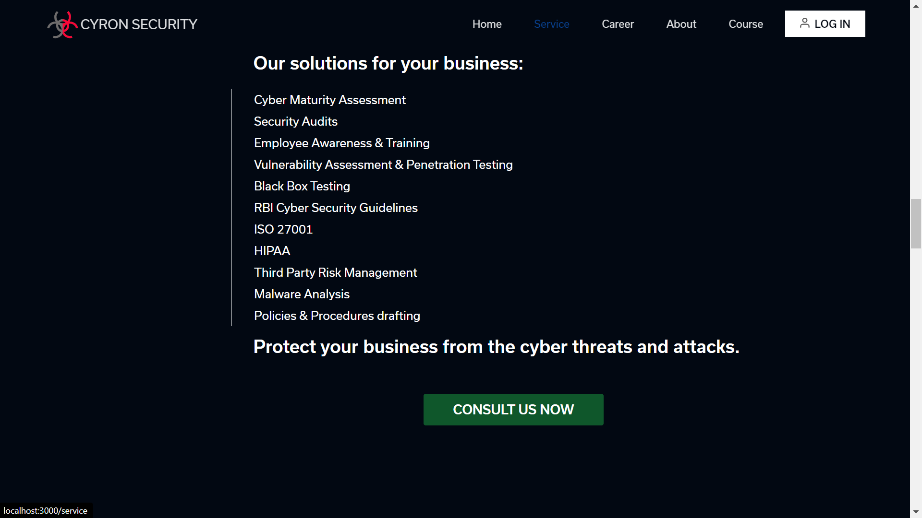

Slide 23
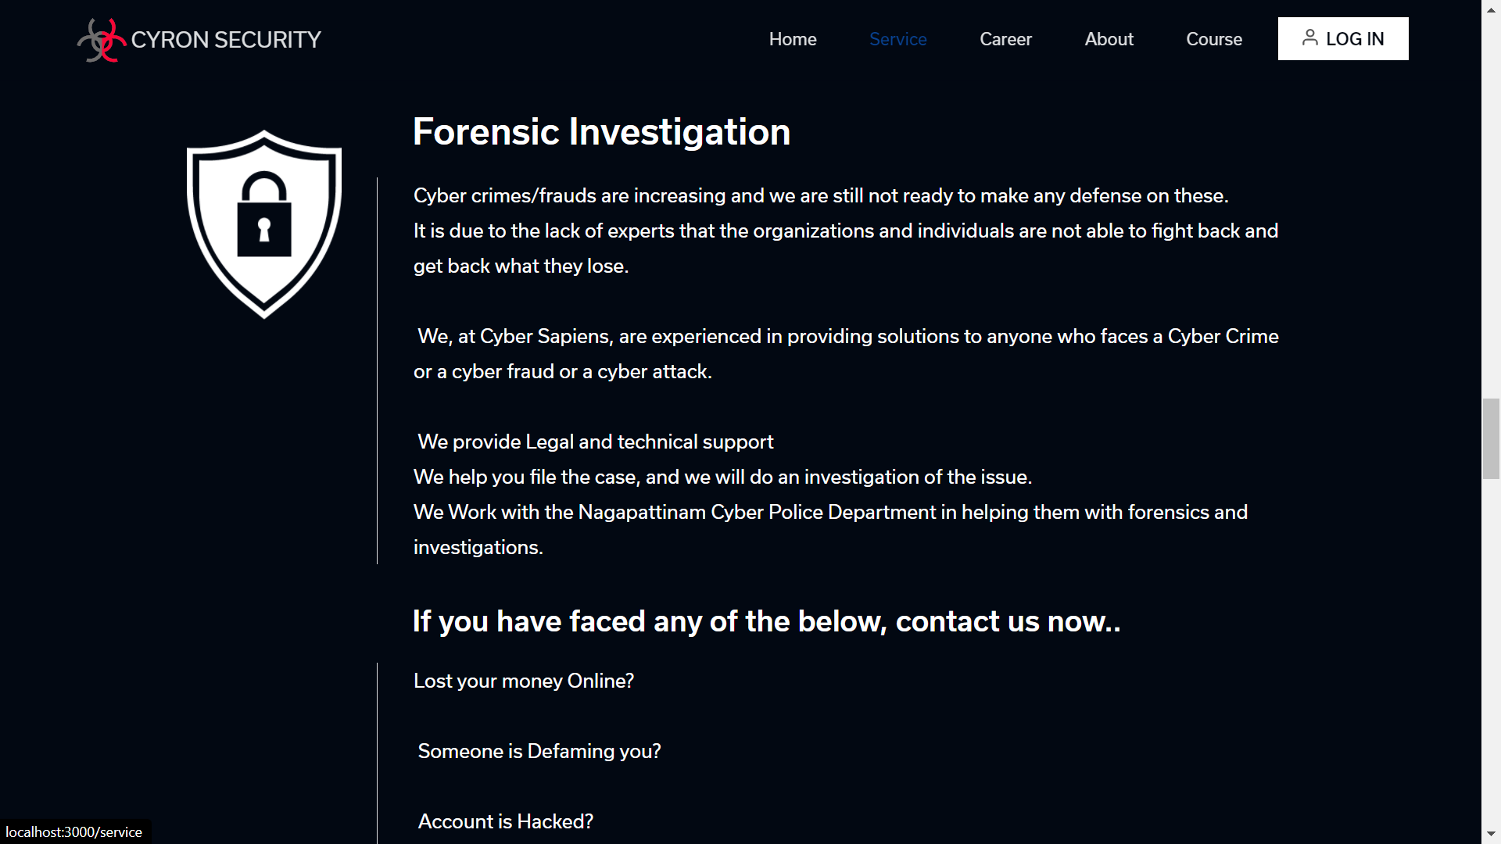

Slide 24
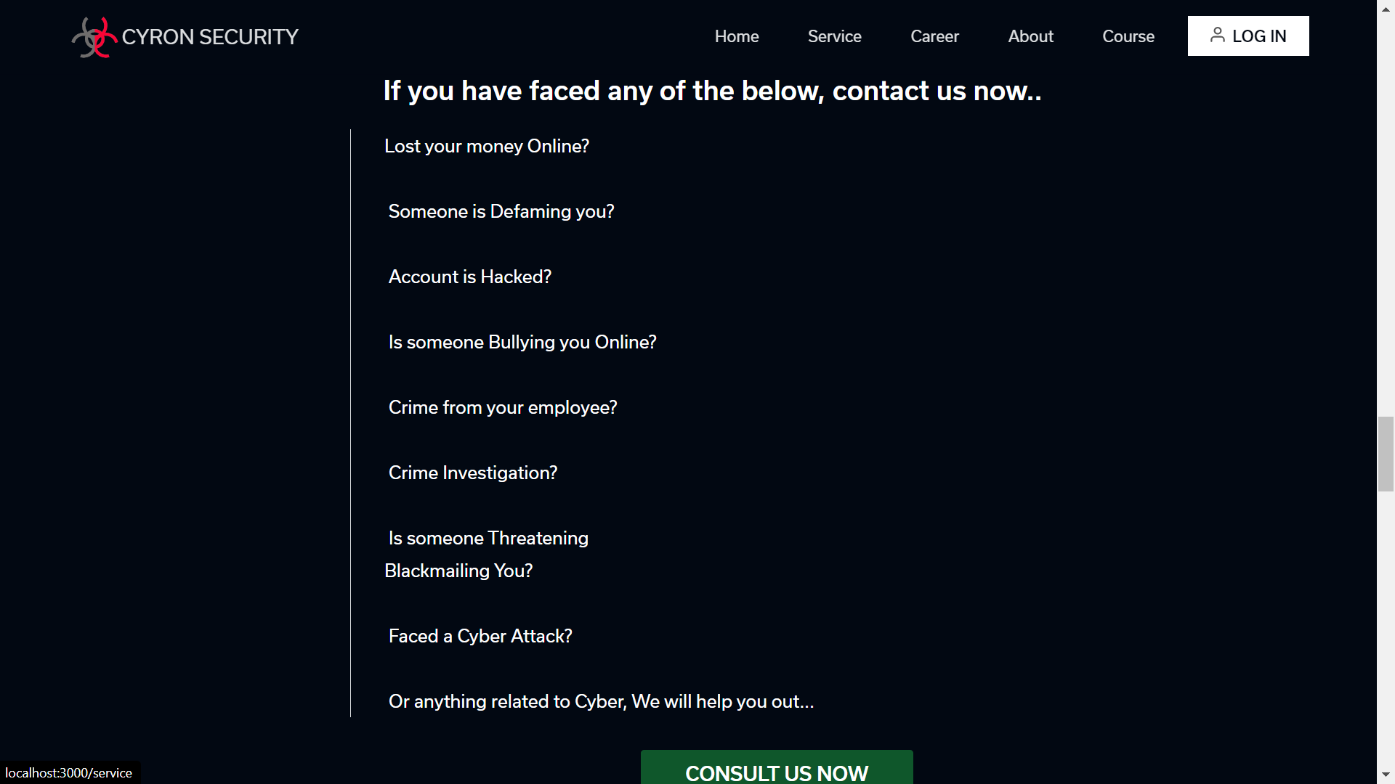

Slide 25
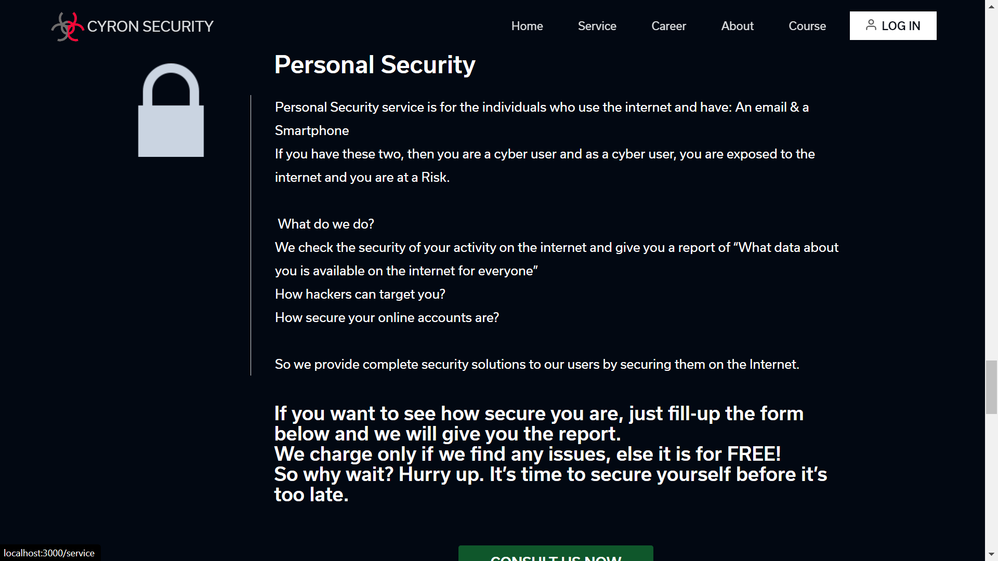

Slide 26
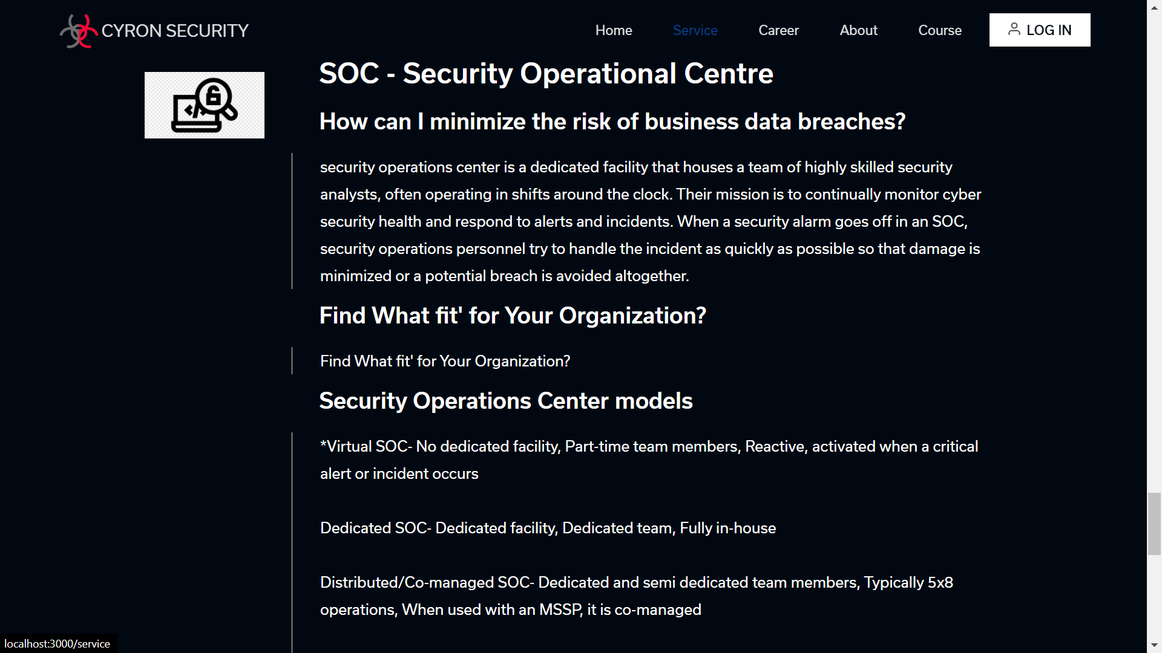

Slide 27
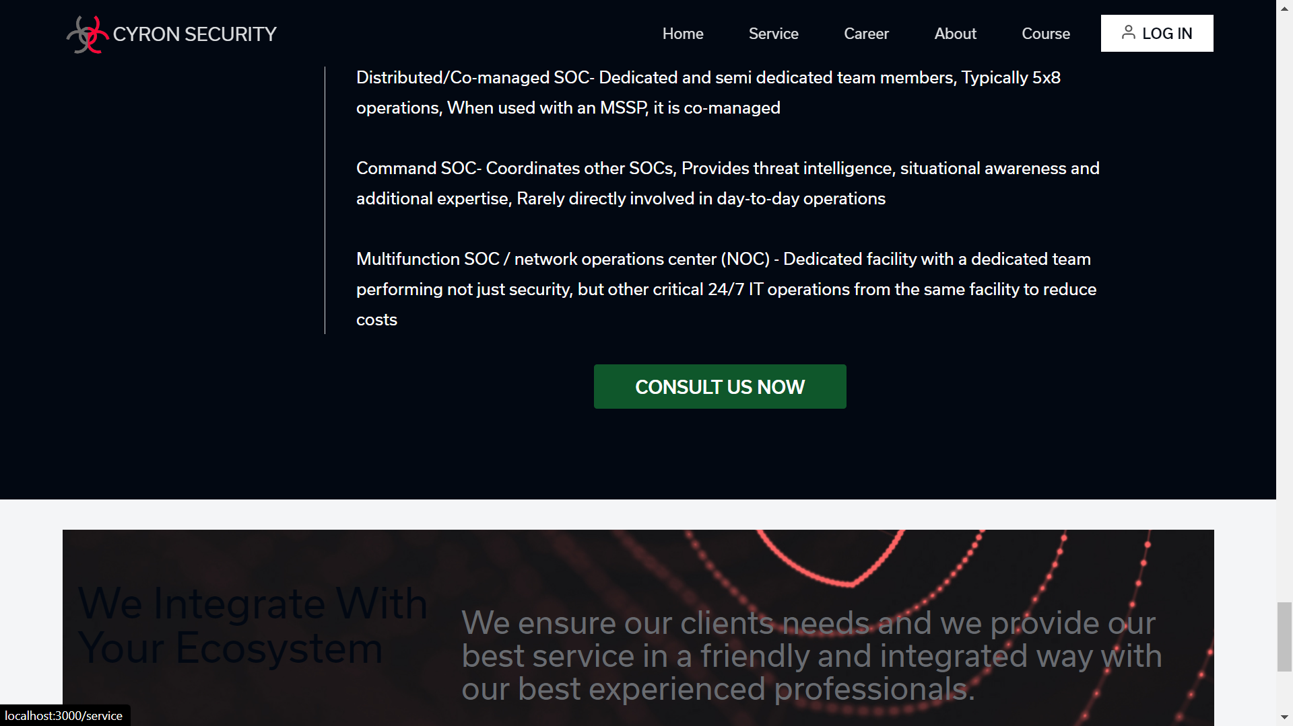

Slide 28
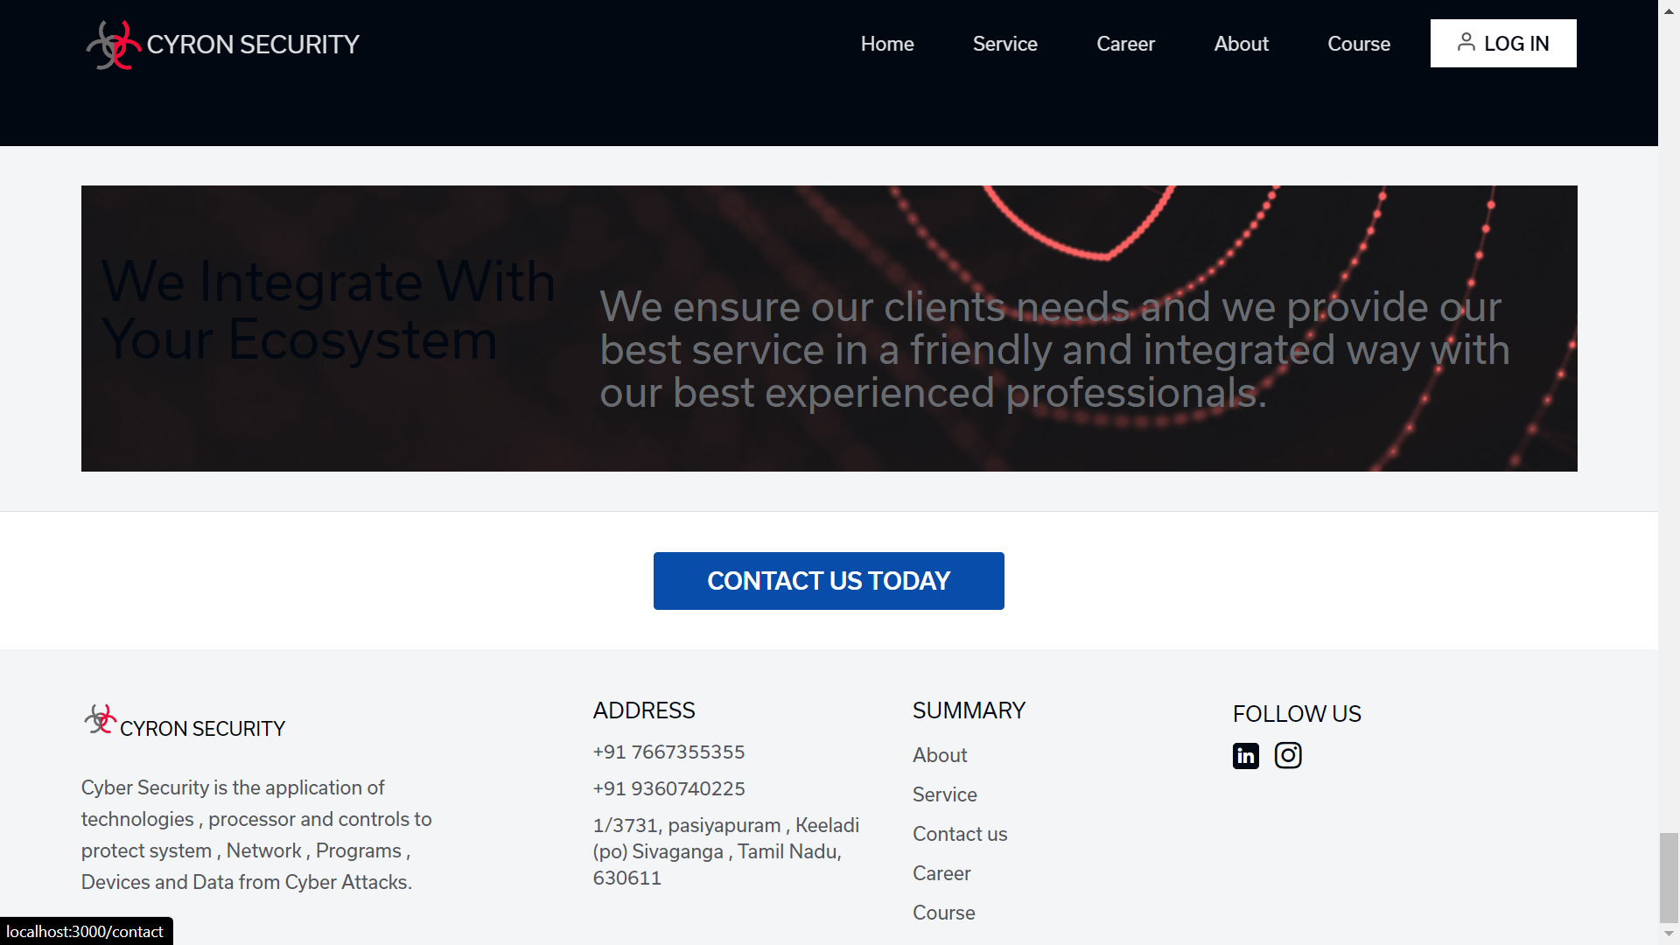

Slide 29
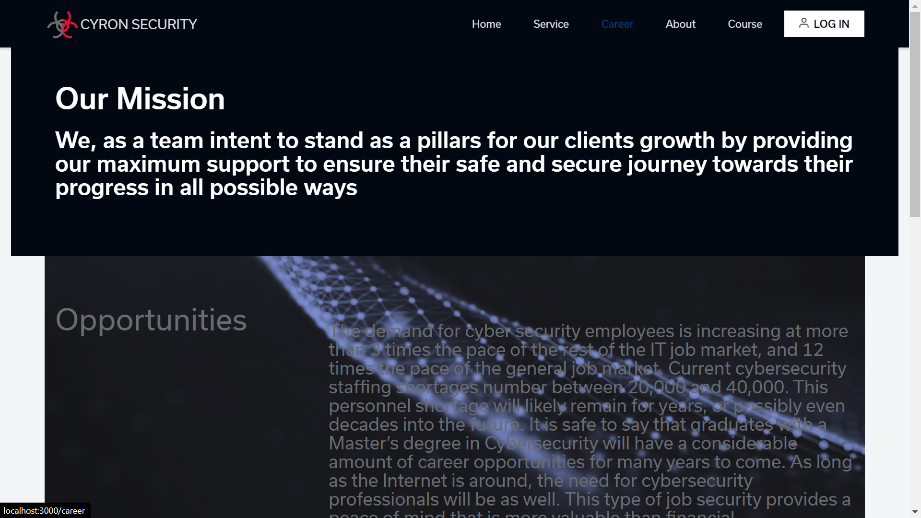

Slide 30
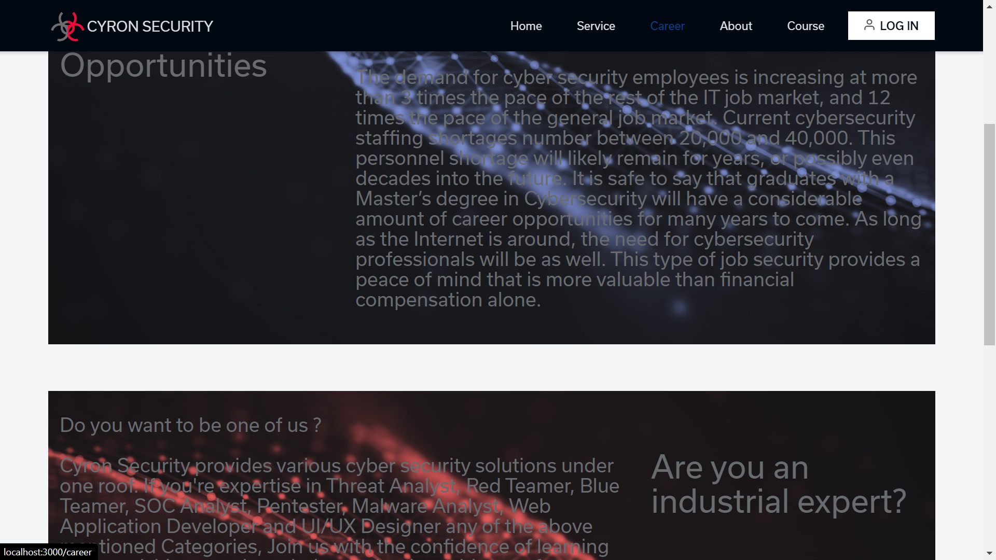

Slide 31
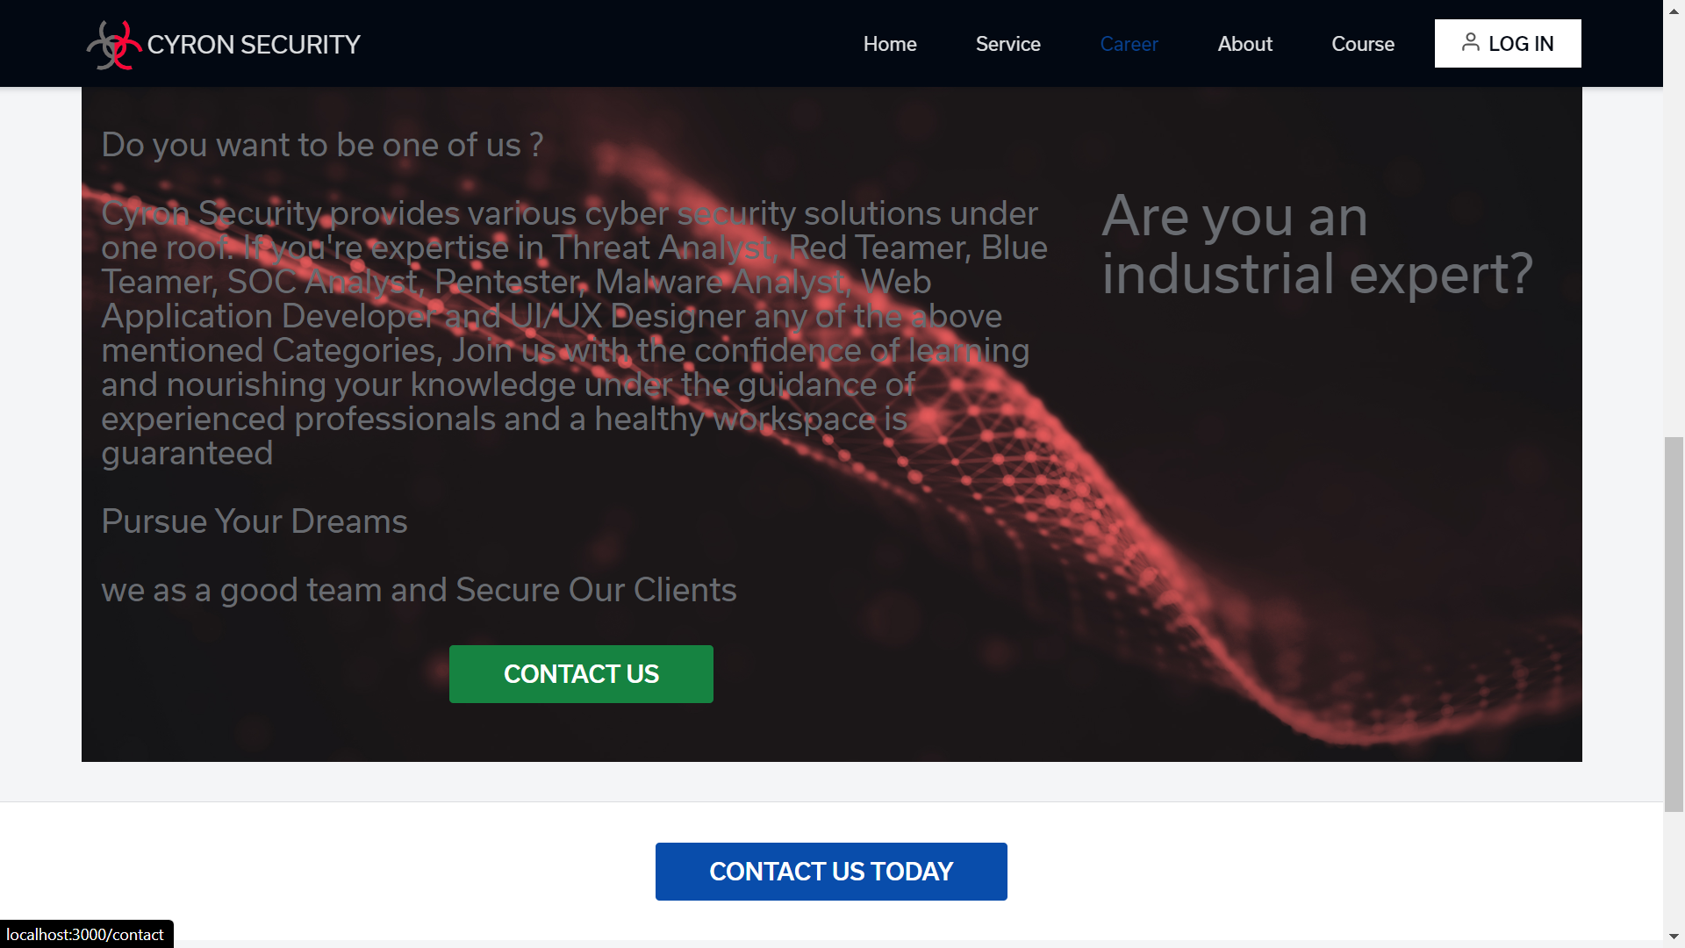

Slide 32
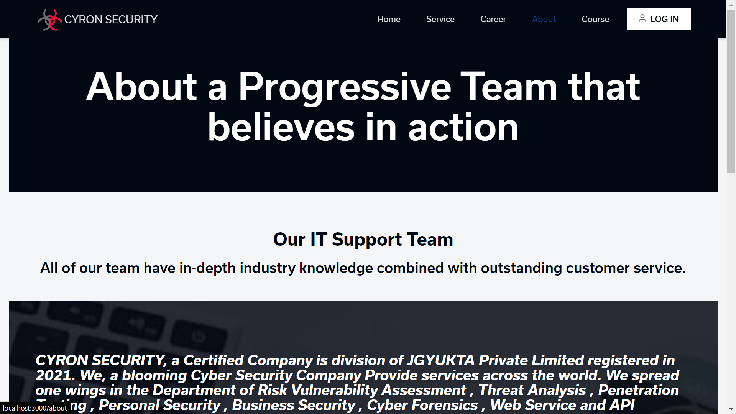

Slide 33


Slide 34
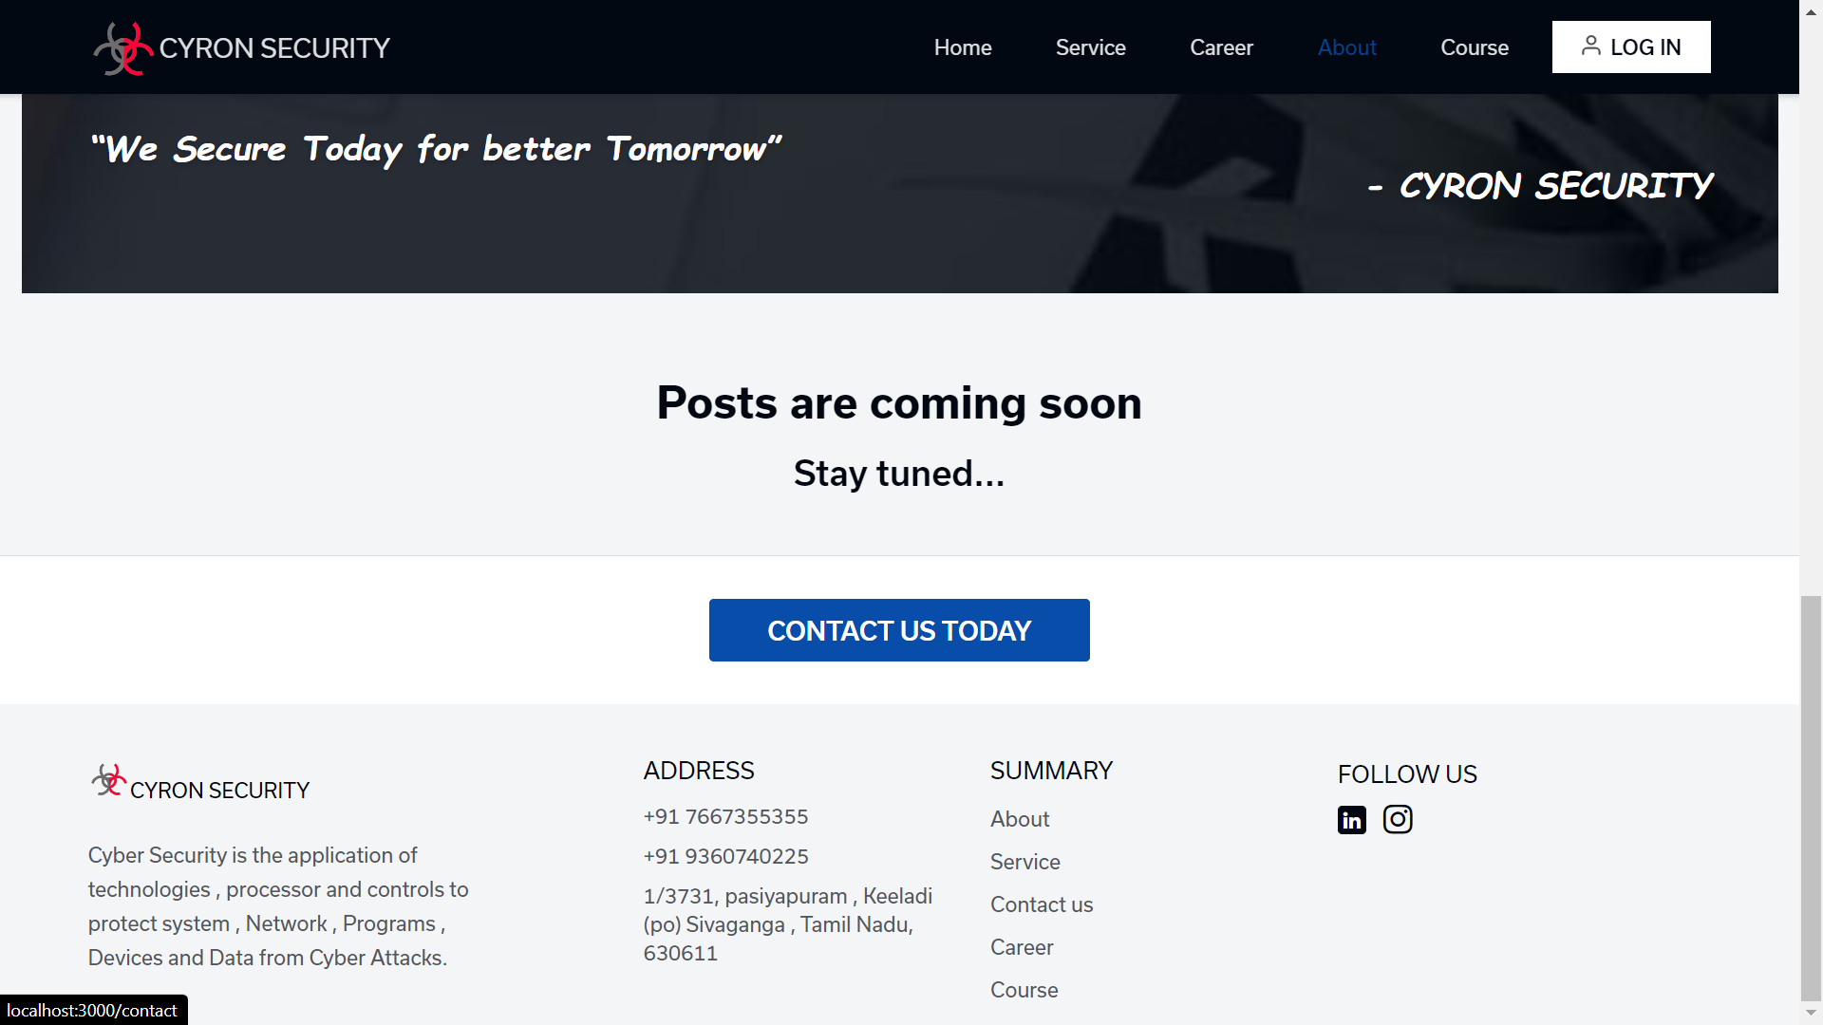

Slide 35
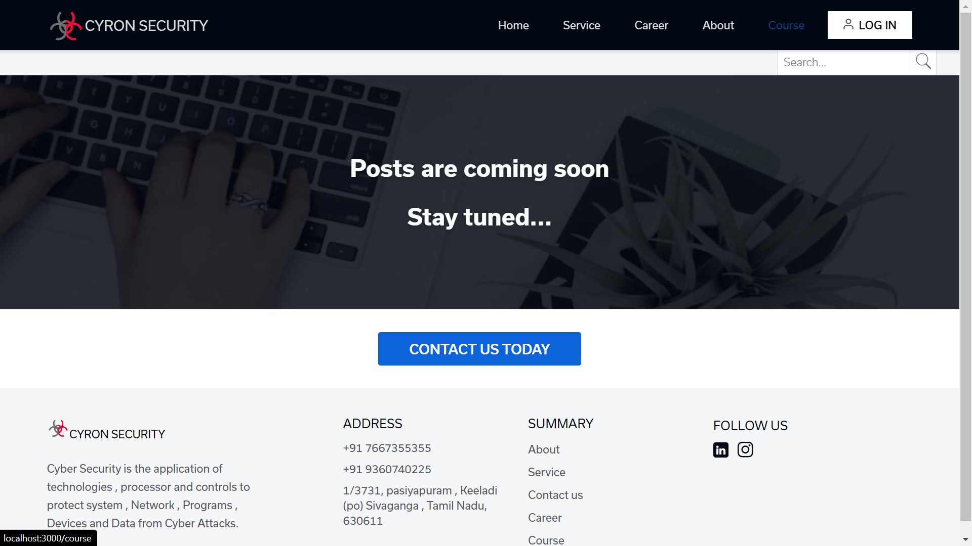

Slide 36
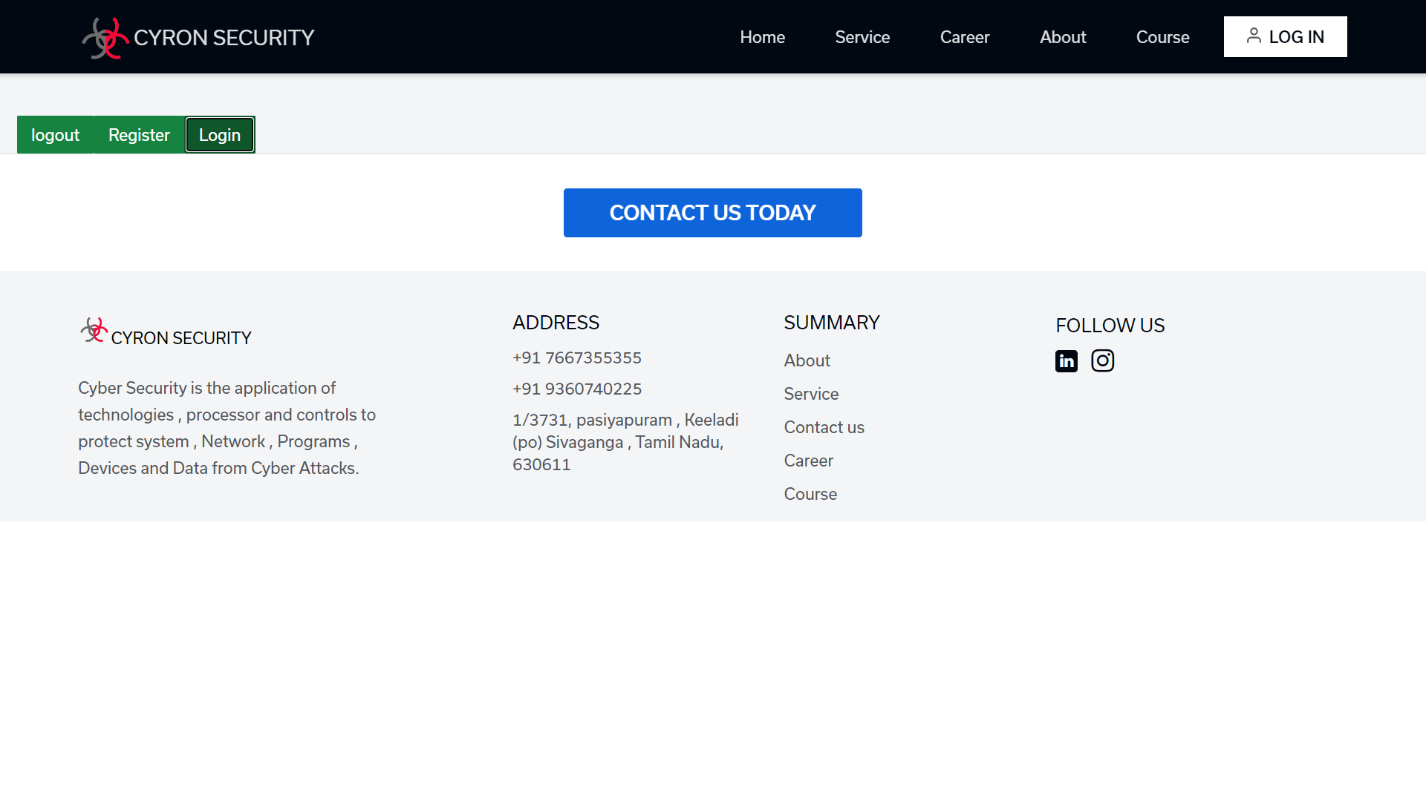

Slide 37
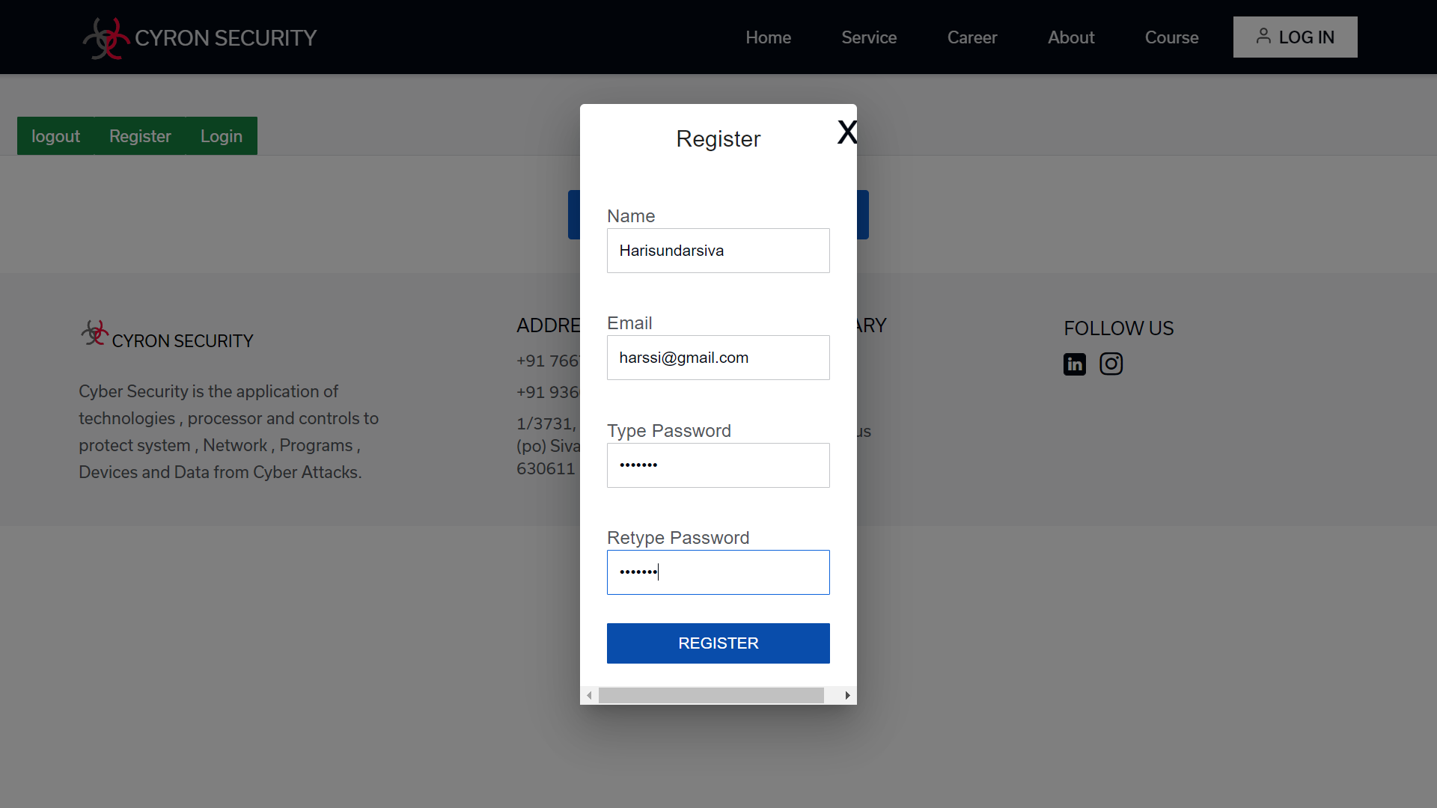

Slide 38
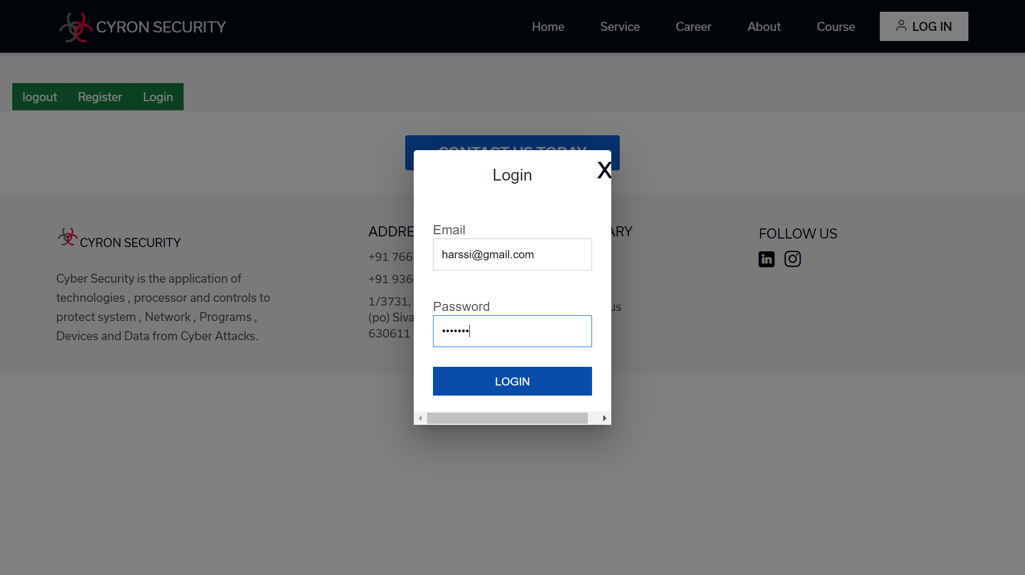

Slide 39
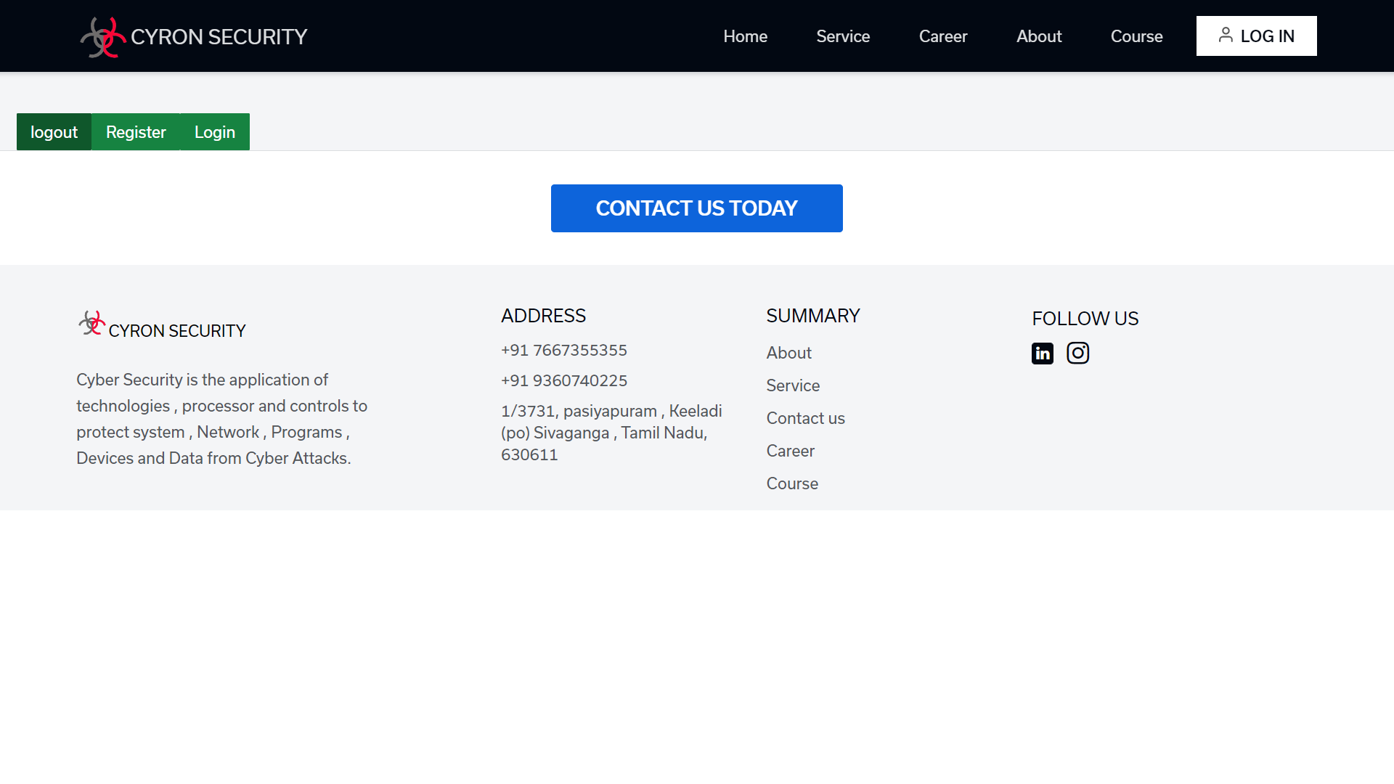

Slide 40
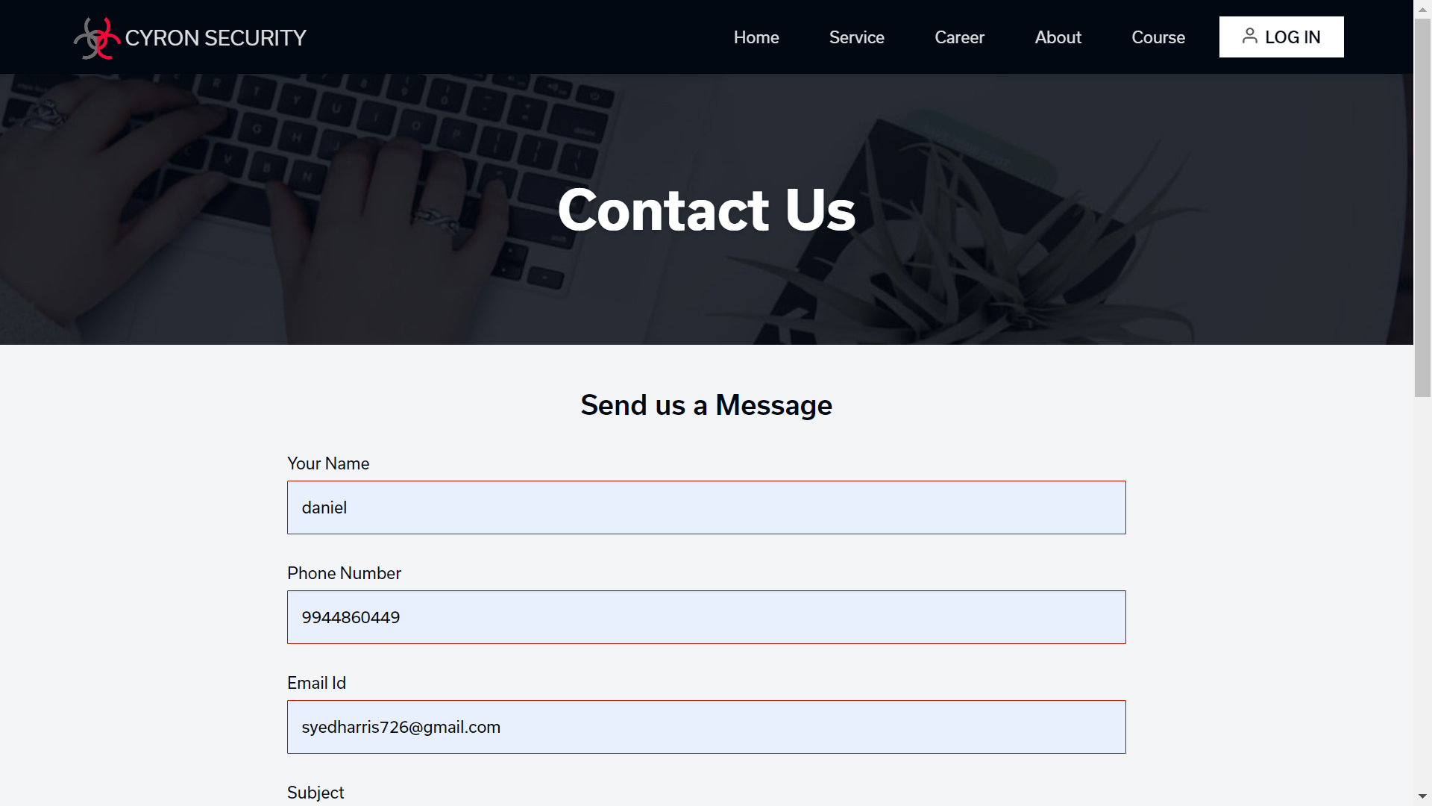

Slide 41
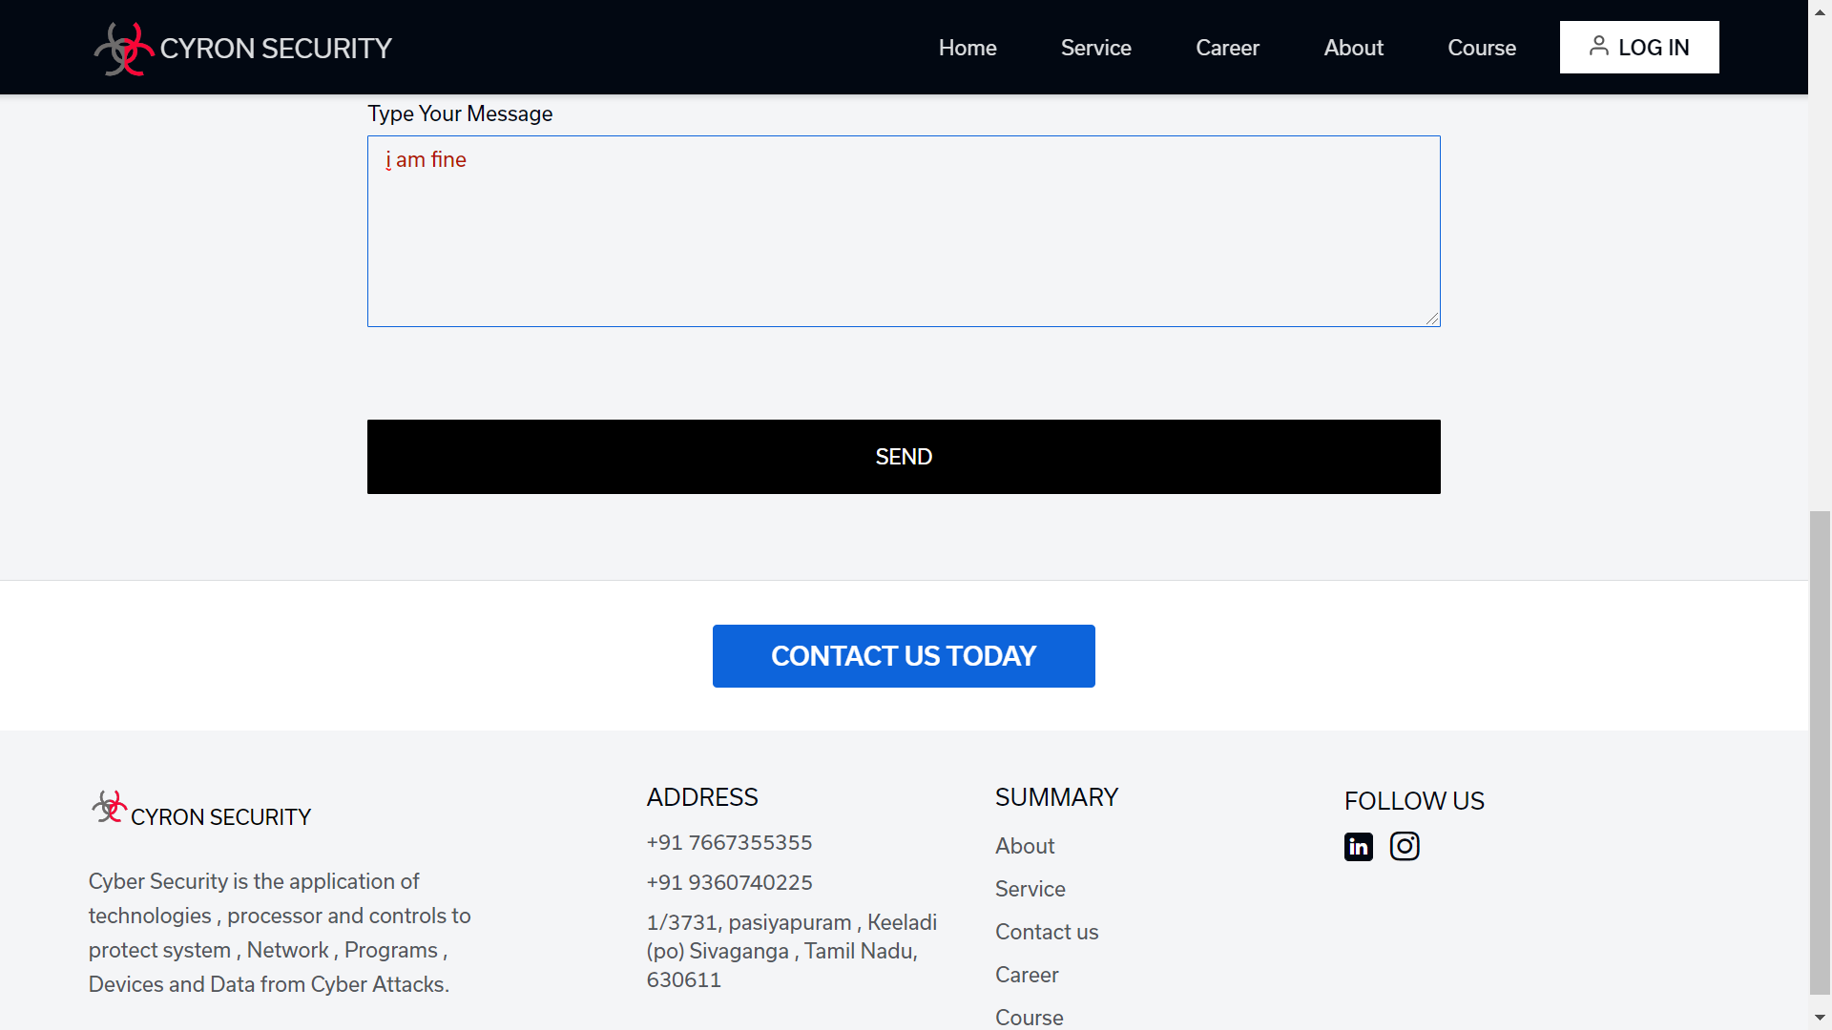

Slide 42
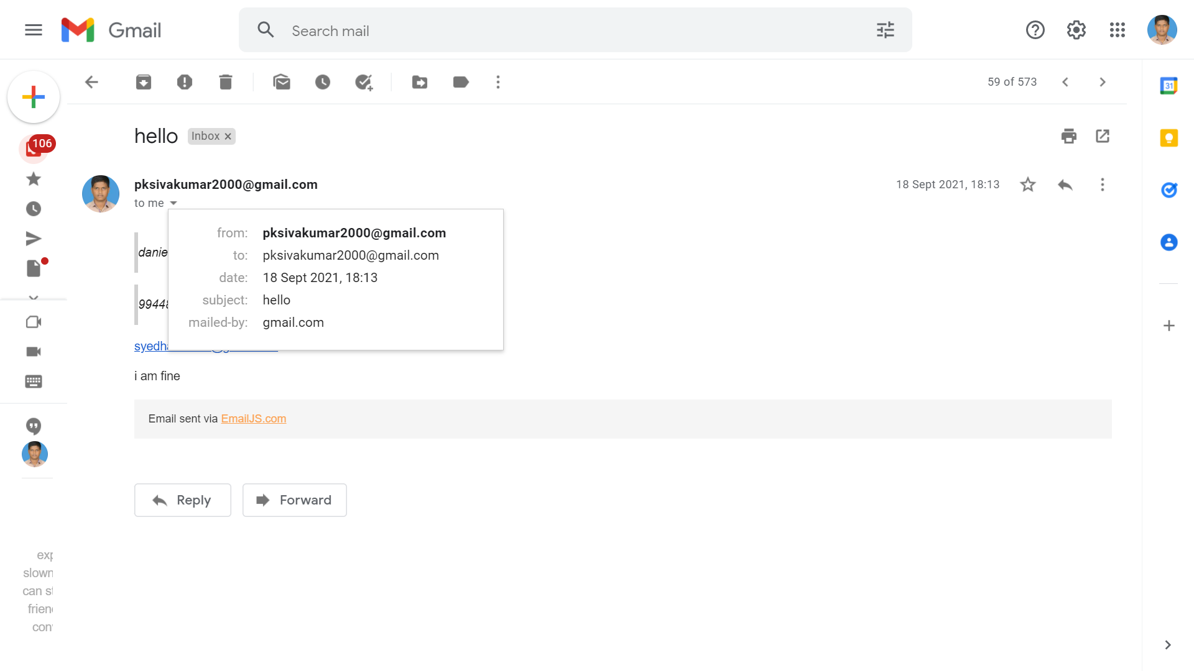
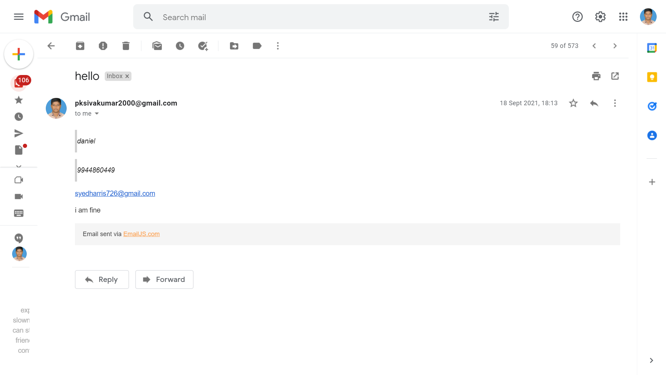

Slide 43
REFERENCES
https://www.javatpoint.com/reactjs-tutorial
https://www.javatpoint.com/nodejs-tutorial
https://www.javatpoint.com/mongodb-tutorial
https://www.emailjs.com/
https://www.section.io/engineering-education/nodejs-mongoosejs-mongodb/
https://www.javatpoint.com/expressjs-tutorial

Slide 44
Thank You

